Slide 1

Town of Maynard Water and Sewer Rates FY 2023
January 4, 2022
Presented by:
Douglas Gardner
Pioneer Consulting Group, Inc.

Slide 2
What has Occurred Since We Last Met?
Consumption has Increased
Much of it is Covid Related
More people at home
Expect stabilization of consumption to pre-Covid levels
Additional revenue will/has boost reserves
Revenues have increased
Old Marlborough Costs Loom
Continue to look long term
Continue to be proactive!

Slide 3
FY 2023 Water Rates
Rates will fund the following:
Distribution Improvements – funds the upgrade of short- term capital improvements
Capital improvements – medium sized, one-time improvements
Capital reserves – increase fund balance – strengthens the enterprise funds
Bring personnel to DEP Minimum Standards (New Employee)
Budget increases
$289,313 - 13.16%
Operating expenses $121,401
50% of New Employee
Debt Increased $33,549
Indirect Costs $133,185
Higher future consumption totals
Any increase will fund reserves and ultimately future capital
Shift from 60/40 Sewer/Water to 60/40 Water/Sewer
Reclassified based on indirect study of 2021

Slide 4
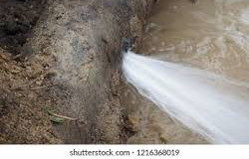
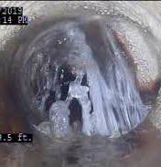
Rate Funded Capital
Water
Distribution Improvements - $50,000
Extraordinary & Unforeseen - $75,000
Small Capital - $50,000
Sewer
I & I - $215,000
WWTF - $40,000
Extraordinary & Unforeseen $75,000

Slide 5
ARPA Funds American Rescue Plan Act
$2,000,000 Allocated to Water Capital Improvement Projects
Well 4 and Well 4A Water Treatment
Engineering Costs for Old Marlborough Road Wells
No effect on water rate
If Bonded $2,000,000 @2% for 20 years
Annual cost approximately $122,313
Effect on rate $0.45/100cf added to each step

Slide 6

New Office Employee
Clean up database
Asset Management
Statutory Compliance
Private Fire
Cross connection
Other services
Assist in collecting Past Due Revenue
Late Notices
Goal is to collect revenue before lien process begins
Water termination
Revenue Collection
Assist in billing for Other services
Position will pay for itself

Slide 7
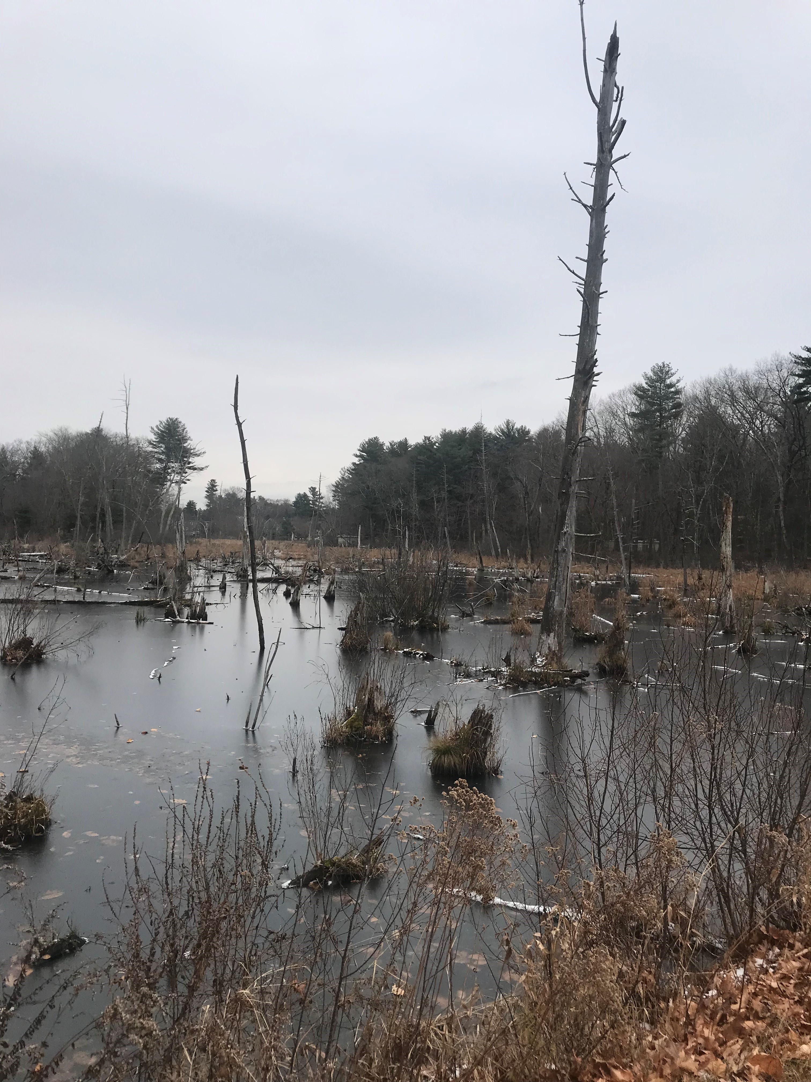
Old Marlborough Road Wellfield, Pump Station and Treatment Plant

Slide 8
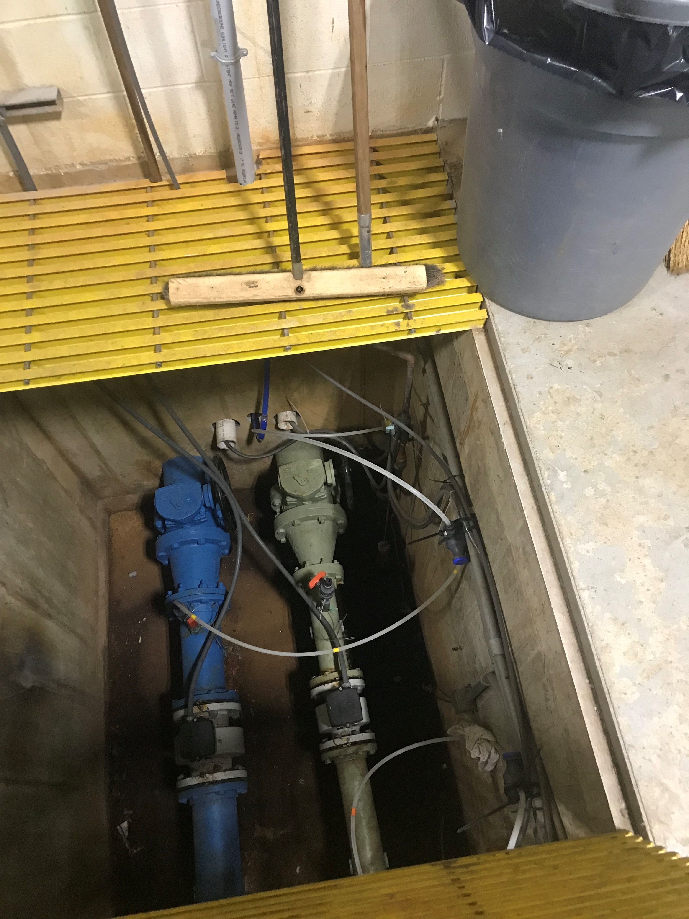
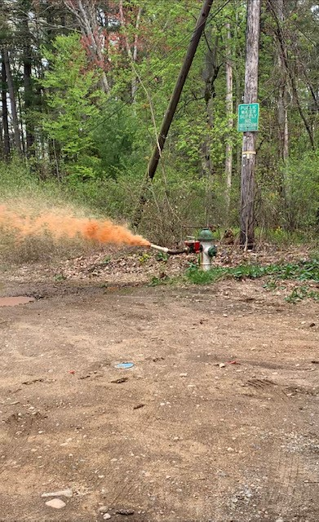
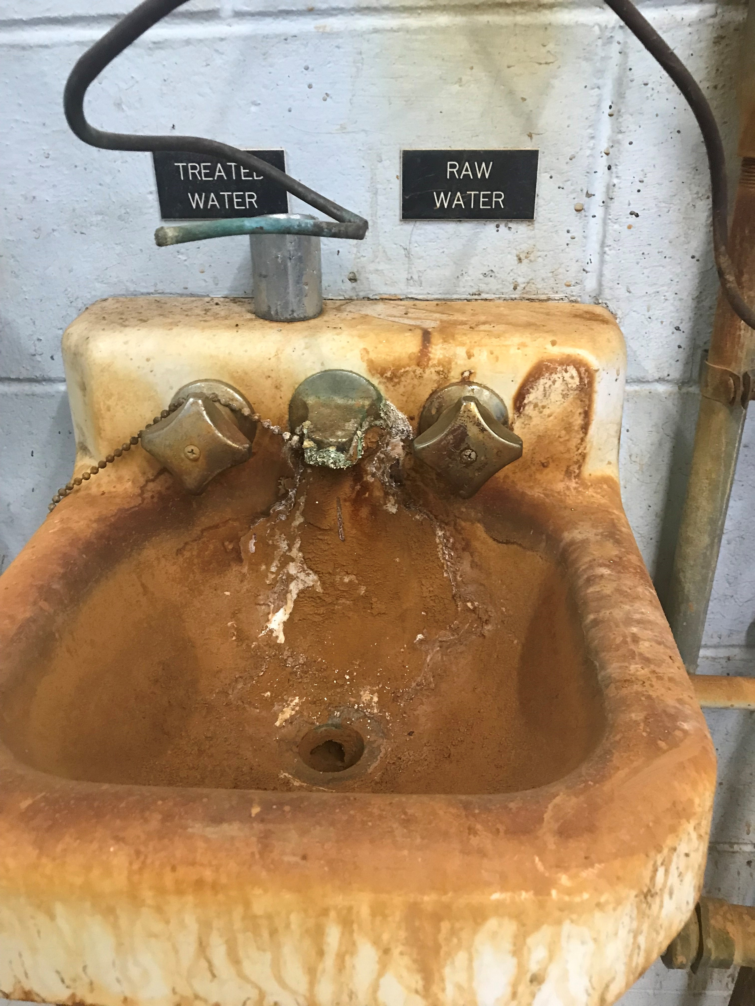
Old Marlborough Road –present day
Dangerous Chemical Feed
Dirty Water
Treated Water / Raw Water

Slide 9
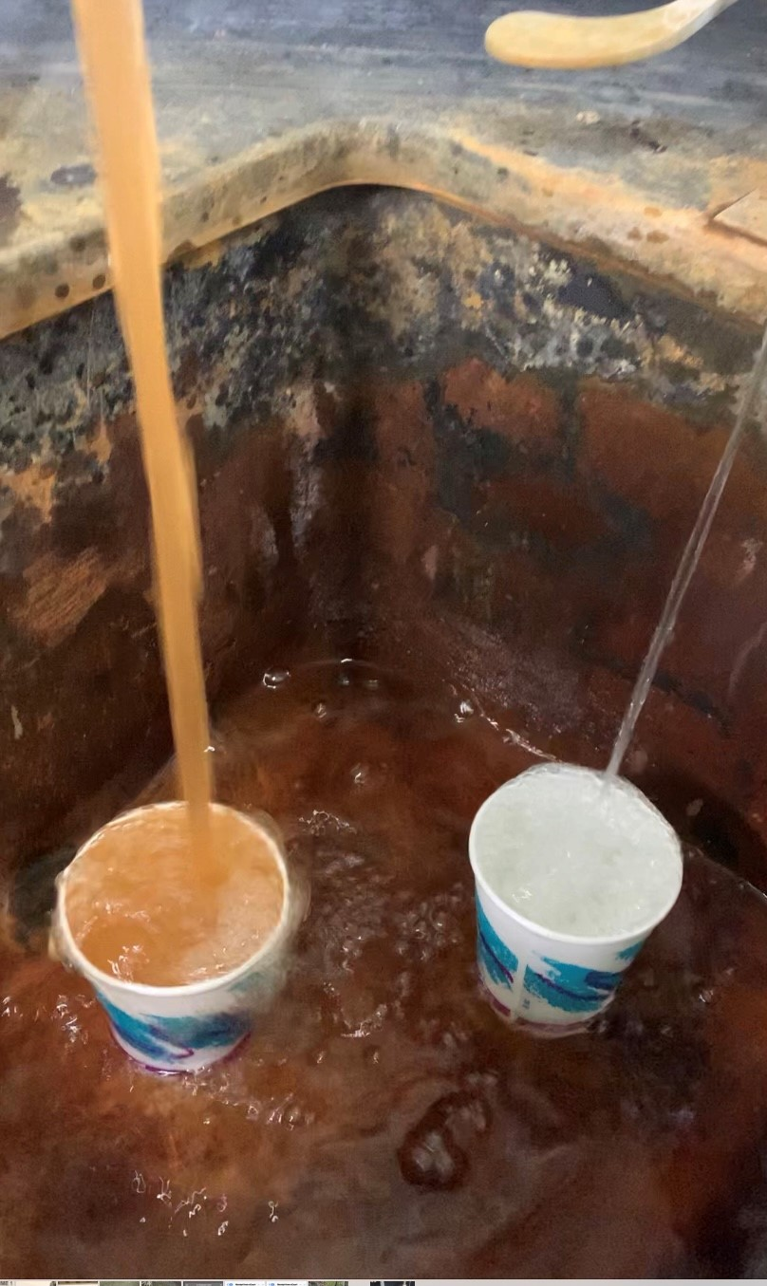
2 New Wells
Re-activate Well 3
New Treatment Facility
Estimated cost $25,000,000
Annual Debt Cost $1,300,000+
Debt service to commence FY 2026 or FY 2027
Enormous impact on budget and rates
Old Marlborough Wellfield & Treatment Plant

Slide 10

Proposed FY 2023 Rate Structure
Maintain same basic rate structure
Minimum charge
4 step conservation-based flow rate
Out of town rates
Private fire protection
Backflow prevention testing
Rates are for FY 2023 Only!
Revise other charges

Slide 11


FY 2023 Water Rates

Slide 13
Current & Proposed Water Debt

Slide 14
Debt Service and Reserves

Slide 15
Water FY 2023 Water Rates – Scenario 1

Slide 16
Impact Analysis – Scenario 1

Slide 17
Water FY 2023 Water Rates – Scenario 2

Slide 18
Impact Analysis – Scenario 2

Slide 19
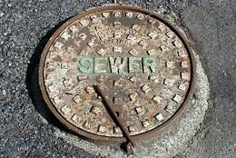
FY 2023 Sewer Rates

Slide 20
FY Sewer2023 Rates
Rates will fund the following:
Capital reserves – increase fund balance – strengthens the enterprise funds
Bring personnel to DEP Minimum Standards (50% of new employee)
WWTP Treatment Plant Capital Improvements $40,000
FY 2023 Budget Decreased $26,591
O&M $111,052
Debt ($40,890)
Indirect costs ($181,751)
I&I $65,000
WWTF Capital $20,000
Higher future consumption totals
Any increase will fund reserves and ultimately future capital

Slide 22
Sewer FY 2023 Sewer Rates – Scenario 1

Slide 23
Impact Analysis – Scenario 1

Slide 24
Sewer FY 2023 Sewer Rates – Scenario 2

Slide 25
Impact Analysis – Scenario 2

Slide 26
2,500 Cubic Feet Quarterly
Current Bill: $504.10
Proposed Rates: $522.05
Quarterly Increase $17.95, 3.56%
Yearly Increase $71.80
2,500 Cubic Feet Quarterly
Current Bill: $504.10
Proposed Rates: $527.15
Quarterly Increase $23.05, 4.57%
Yearly Increase $92.20
Average Residential Customer
2,500 CF Quarterly
Scenario #1
Average Residential Customer
2,500 CF Quarterly
Scenario #2
Average Residential Customer Combined Water and Sewer Bill 2,500 CF Quarterly

Slide 27
Other Rates and Charges

Slide 28

Conclusion
Continue the good work of the past few years
Old Marlborough Project looms
Plug the “rate gap” with reserves as debt matures
Fact: Funding capital through a combination of rates, new debt and reserves results in lower rates in the long run.
Must Continue to build reserves

Slide 29

Questions

