Slide 1

Town of Maynard
Water & Sewer Rates FY 2024
March 7, 2023

Slide 2

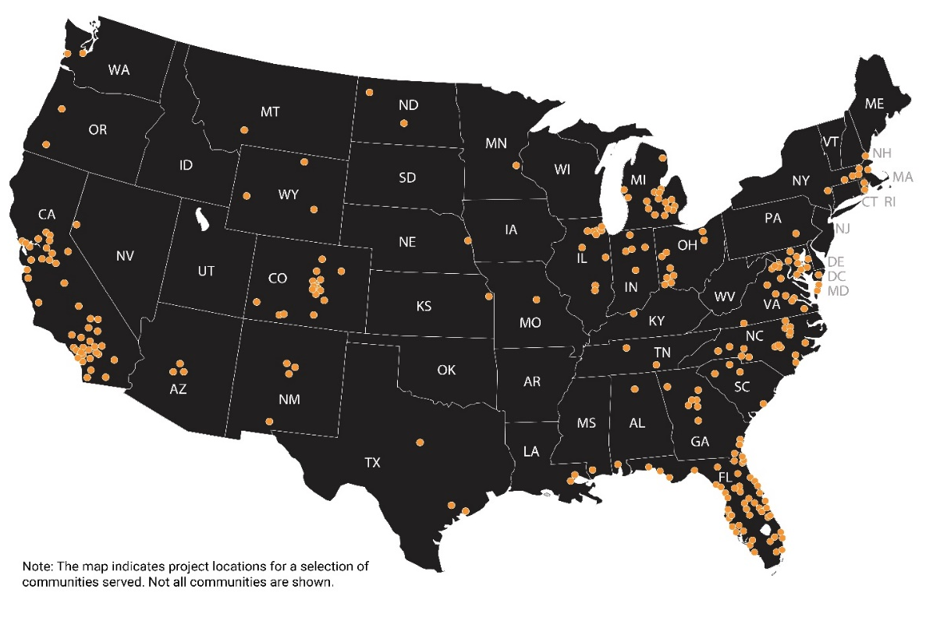
About Stantec Financial Services
300+
1.5K+
35+
$4B+
Team
Combined years of experience
Studies in the last 10 years
Specialists in utility financial management
Debt supported in past five years
Deborah Kloeckner
Manager
>360
Angela Clay
Business Analyst
Communities we have served, accounting for 25+% of the US population!

Slide 3
FY 2024 Update
  FY 2024 Budget impacted by inflation
    6.4% national inflation rate as of January 2023
  Existing water debt payments will drop $300k in FY 2024
  New water debt estimated at $300k in FY 2024 and increase to $510k each year thereafter
  FY 2023 indirect cost allocation shifted costs from sewer (40%) to water (60%)
  Two options presented today:
  7% water revenue increase & 4% sewer revenue increase
  9% water revenue increase & 4% sewer revenue increase (additional $50k in cash)

Slide 4
Water Revenue Requirements Analysis
Building OMR reserves beginning in FY 2024 (additional 2% generates $50k)
Indirect costs allocated 60% to water (previously 40%)
New debt $300k in FY 2024, $510k each year thereafter
Operating costs planned to increase 3% per year beyond FY 2024 budget

Slide 5
Sewer Revenue Requirements Analysis
Increased spending for WWTP capital and I&I improvements
Indirect costs allocated 40% to sewer (previously 60%)
Operating costs planned to increase 3% per year beyond FY 2024 budget

Slide 6
Rate Structure Scenarios
  Water Rate Structure Options - 7% revenue increase
  7% rate increase applied to minimum charge and all tiers
  Lower increase applied to 1st step and 2nd step; higher increases to minimum charge and higher steps
  Water Rate Structure Options - 9% revenue increase
  9% rate increase applied to minimum charge and all tiers
  Lower increase applied to 1st step and 2nd step; higher increases to minimum charge and higher steps
  Sewer Rate Structure Recommendation
  No increase to minimum
  Higher increase to 2nd Step & 3rd Step

Slide 7
Scenario 1A – Revenue Recovered from Minimum & High Tiers

Slide 8
Sewer Recommendation

Slide 9
Scenario 1A – Combined Water & Sewer Impacts

Slide 10
Scenario 1A – 7% Across All Water Rates

Slide 11
Scenario 1A – Combined Water & Sewer Impacts

Slide 12
Scenario 2A – Revenue Recovered from Minimum & High Tiers

Slide 13
Scenario 2A – Combined Water & Sewer Impacts

Slide 14
Scenario 2B – 9% Across All Water Rates

Slide 15
Scenario 2B – Combined Water & Sewer Impacts

Slide 16
Summary
  Higher pressure on water fund due to indirect cost allocation and new debt service
  OMR project looms and reserves should be set aside if possible
  2 options presented for water revenue requirements; 4 scenarios presented for water rate structures

Slide 17

Questions & Discussion

